Slide 1
Rice University Data Analytics and visualization Bootcamp
PROJECT 1
TITLE: The Impact of Covid-19 on Suicide Rate
Group Members: Armine Arutyunyan
Birundha Varatharajan
Ammanesi Adamu
Stan Ejiobi

Slide 2
Introduction
Covid-19, a world pandemic which broke out in late 2019 brought significant changes to the world. Despite its direct impact on sickness and mental health around the world, its effect was also felt on suicide rate.

Slide 3
Scope
The goal of this project is:
To examine the impact of Covid-19 on suicide rate. The task includes gathering information on global suicide rate and recorded Covid-19 cases.
The information will be broken down using different strategies to identify and point out any patterns.

Slide 4
Data Source
Data was pulled form the following sources to capture suicidal trends as impacted by Covid-19.
Name of website(Website url)
Name of website(Website url)
World Bank (www.worldbank.org)
API
http://api.worldbank.org/v2

Slide 5
Observation
Name of website(Website url) showed that ……………
Name of website(Website url) showed that ……………
Name of website(Website url) showed that ……………

Slide 6
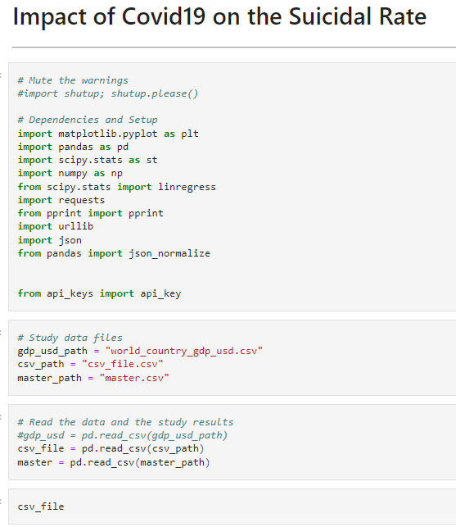
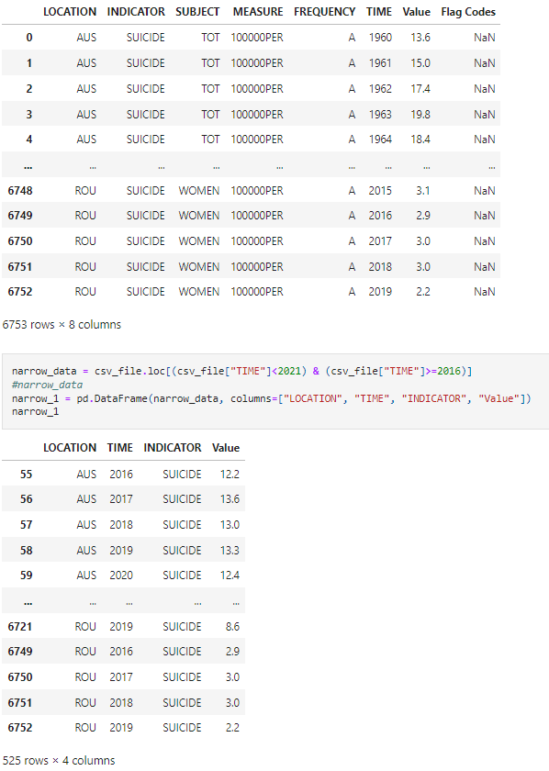
Code

Slide 7
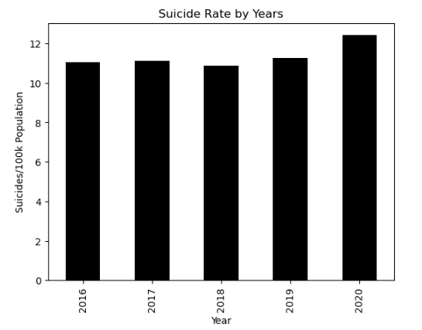
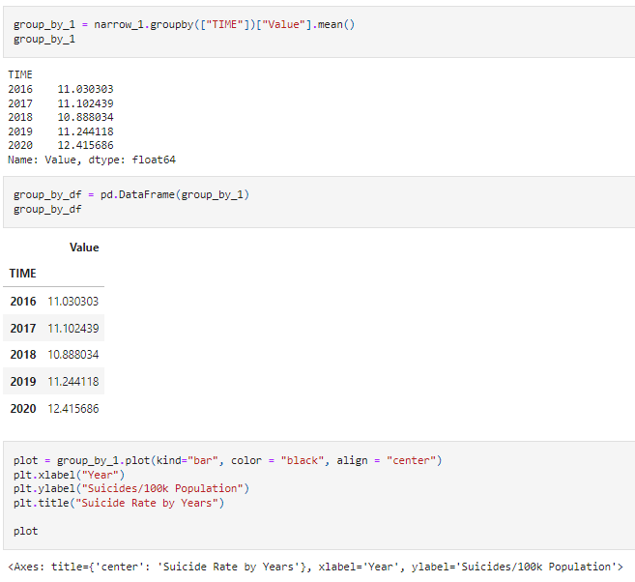
Code continued ….

